Slide 1
DEVOPS AUTOMATION
PRESENTED BY:
ASEEM GOEL

Slide 2
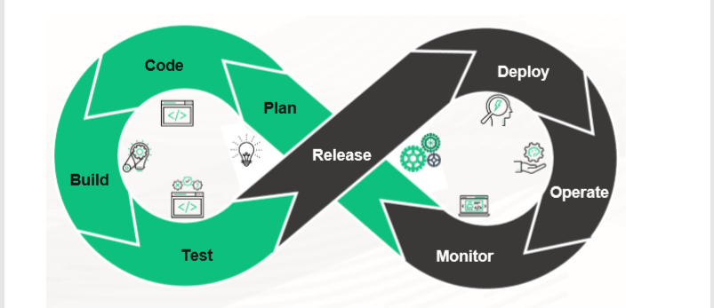
Code Generation tools help in creating applications from scratch,that can run on specific platform
Have the capability to generate bug free reliable basic setup fold
There exist some code Generators that can deliver code in accordance with pre defined functionalities.

Slide 3
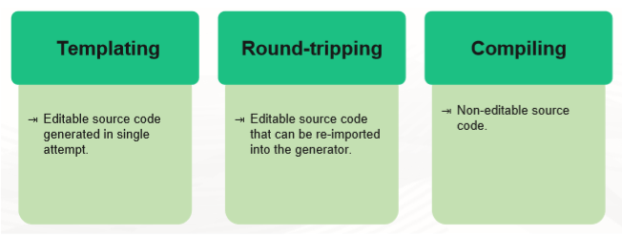
CATEGORIES OF CODE GENERATORS
Code Generators can also be categorised as follows:
Database script Generators : Relational database models are created and updated by means of incremental scripts
Application source code generator:Code is generated in any programming language

Slide 4
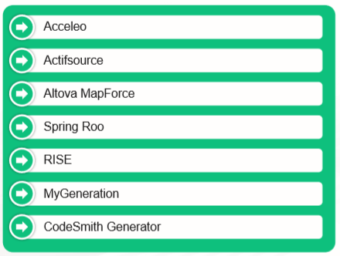
COMMON CODE GENERATION TOOLS

Slide 5
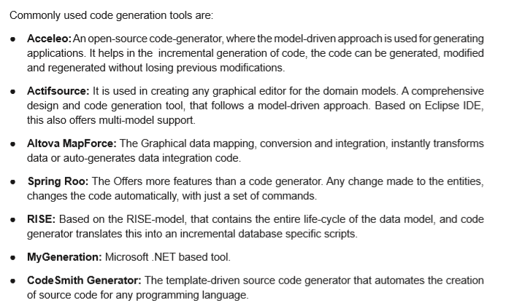

Slide 6
WHY TO USE
Why NOT to Use Code Generation
Productivity:- With code generation you write the generator once and it can be reused as many times as you need. Providing the specific inputs to the generator and invoke it is significantly faster than writing the code manually, therefore code generation permits to save time.
Simplification:- With code generation you generate your code from some abstract description. It means that your source of truth becomes that description, not the code. That description is typically easier to analyse and check compared with the whole generated code.
Portability:- Once you have a process to generate code for a certain language or framework you can simply change the generator and target a different language or framework. You can also target multiple platforms at once. For example, with a parser generator you can get a parser in C#, Java and C++. Another example: you might write a UML diagram and use code generation to create both a skeleton class in C# and the SQL
Maintenance:- When you use a code generator tool your code becomes dependent on it. A code generator tool must be maintained. If you created it you have to keep updating it, if you are just using an existing one you have to hope that somebody keep maintaining it or you have to take over yourself. So the advantages of code generation are not free.
Complexity:- Code generated automatically tend to be more complex than code written by hand. In this second case the generated code can do more than what you want, but this is not necessarily an advantage. Generated code is also surely less optimized than the one you can write by hand. Sometimes the difference is small and not significant, but if your application need to squeeze every bit of performance code generation might not be optimal for you.

Slide 7
Advantages of Code Generation
It can generate bug free set of codes without human intervention
Code generator can automate the development process
Code generators keep a track of code development lifecycle
Testing and bug fixing becomes easier

